Slide 1
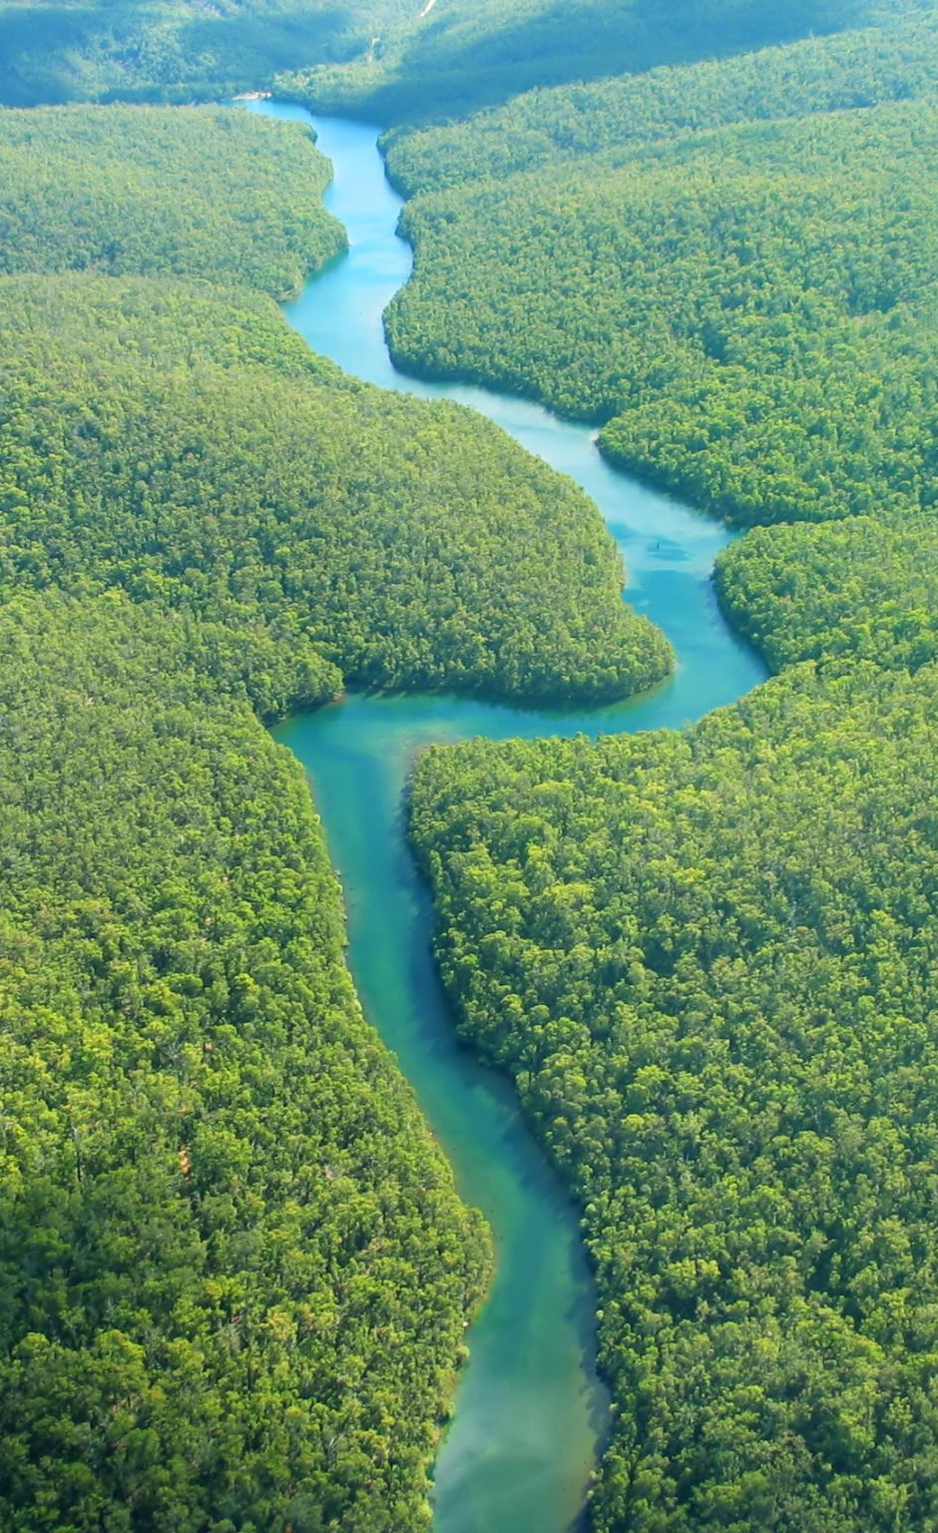
Forest and Water Resources
An Overview of Their Importance, Challenges, and Conservation
Team Member:
Sayyad Faizan
Qazi Arqam

Slide 2
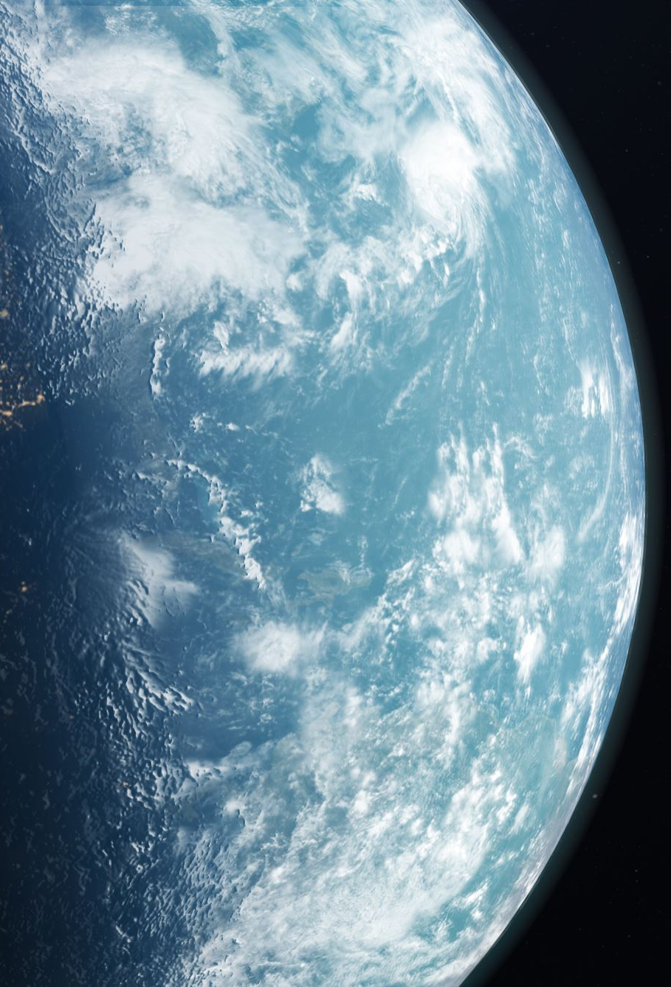
Introduction
Overview of Forest and Water Resources
Definition of forest resources
Definition of water resources
Importance of these resources to the ecosystem and human life

Slide 3

What is Resources?
Any thing, which is useful to man, or can be used to produce a useful thing, can be referred as ‘resources’.
Example: rocks, minerals, soil, rivers, plants & animal.

Slide 4
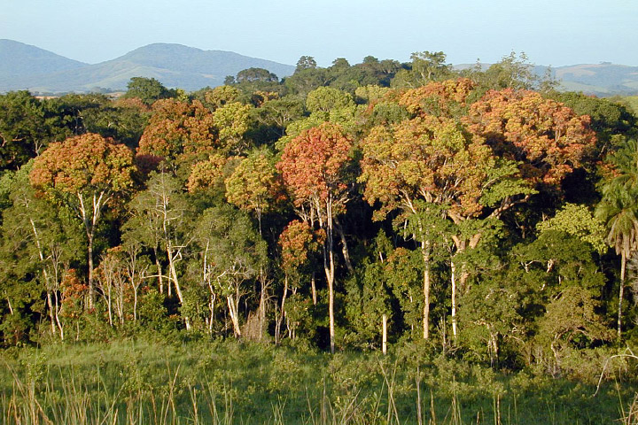
1. Forest Resources
Forest is an area with a high density of trees, together with other plants, covering a large area of land.
Forests are home to 50% to 90% of earth’s species.
These forests produces innumerable material goods

Slide 5
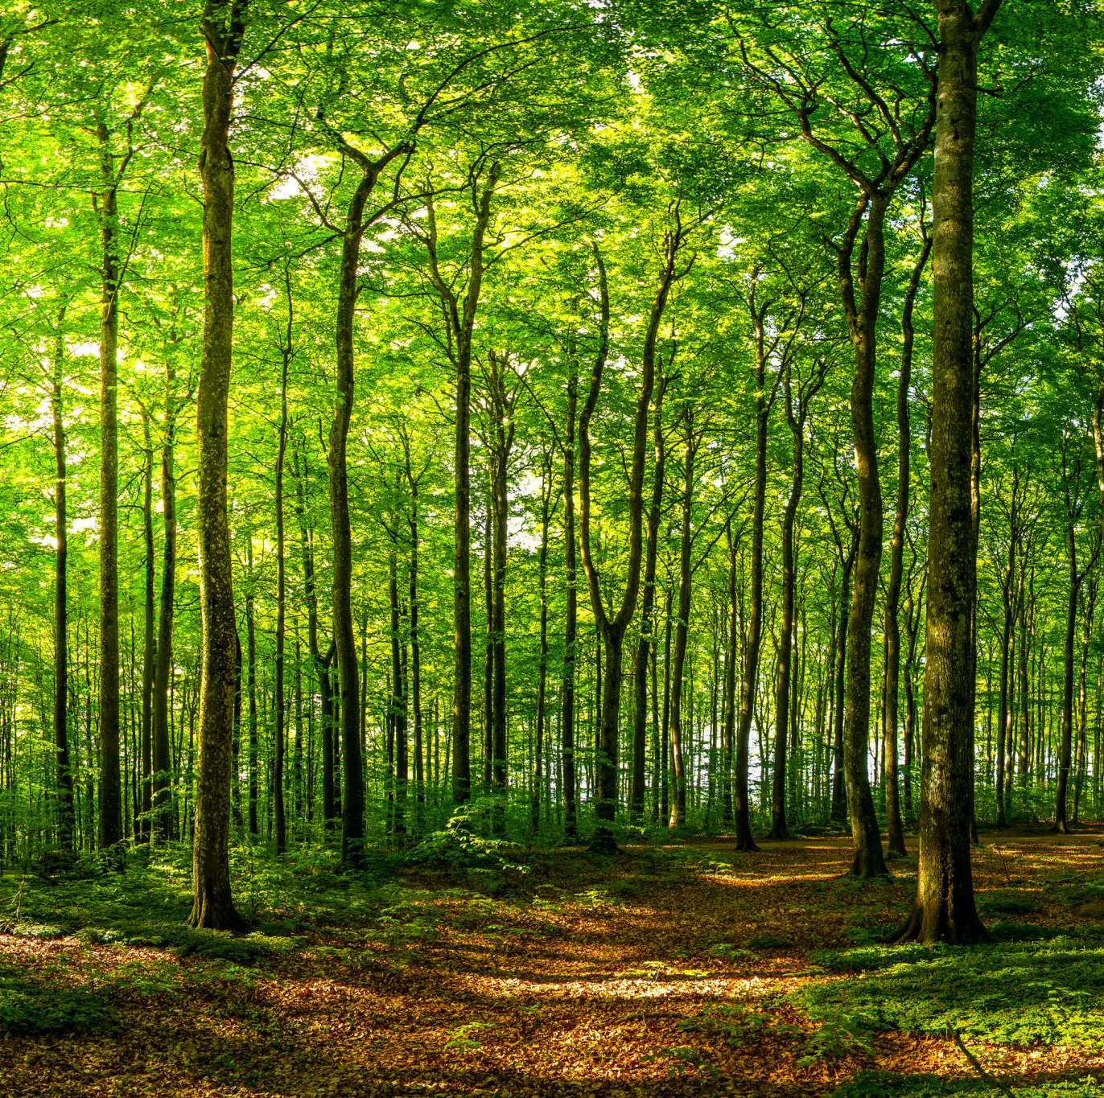
Importance of Forests
Ecological Benefits
Biodiversity support
Carbon sequestration
Soil preservation
Economic Benefits
Timber and non-timber products
Recreation and tourism
Social Benefits
Cultural significance
Livelihoods for indigenous communities

Slide 6
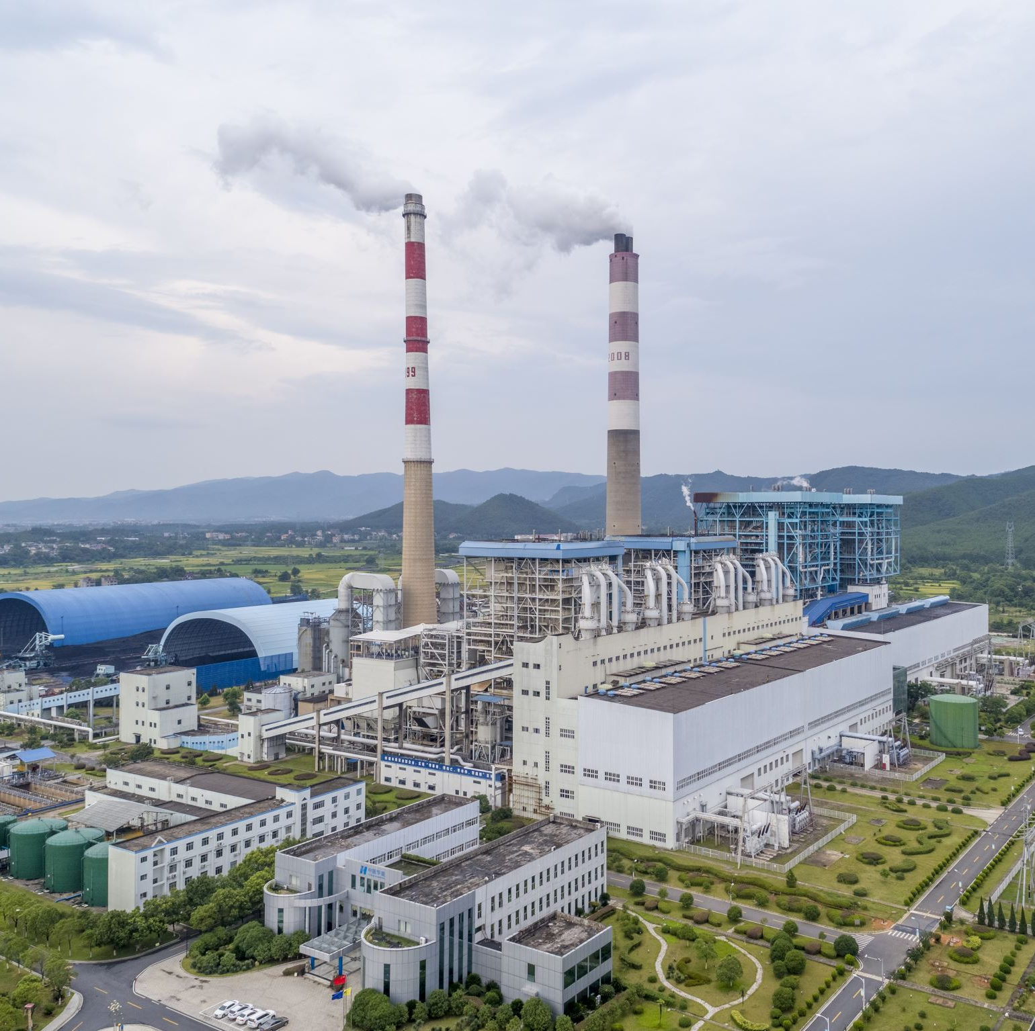
Threats to Forest Resources
Deforestation
Logging
Agricultural expansion
Climate Change
Increased frequency of forest fires
Shifts in species distribution
Pollution
Impact of acid rain
Industrial pollution

Slide 7
Conservation of Forest Resources
Sustainable Management Practices
Selective logging
Reforestation and afforestation
Protected Areas
National parks
Wildlife reserves
Community Involvement
Participatory forest management
Indigenous knowledge and practices

Slide 8
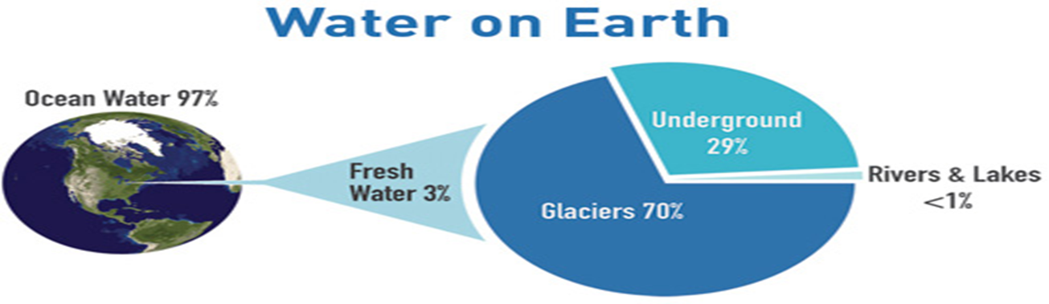
2. Water Resources
Earth is known as the "Blue Planet" because 71 % of the Earth's surface is covered with water.
About 97% of the earth’s water is strong saline.
The rest 3% is freshwater.
Fresh Water Sources
Glaciers- 70%
Underground Water- 29%
Rivers and lakes- 1%
Only 1 % is pure and usable water is pure and usable water.

Slide 9
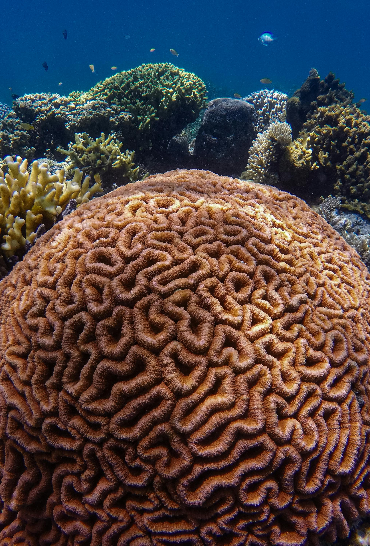
Importance of Water Resources
Water is an essential natural resource for sustaining life.
Water is one of the most important substance on earth.
If there is no water there would be no life on earth.
All plants and animals must have water to survive.
Water is a renewable but limiting resource.

Slide 10
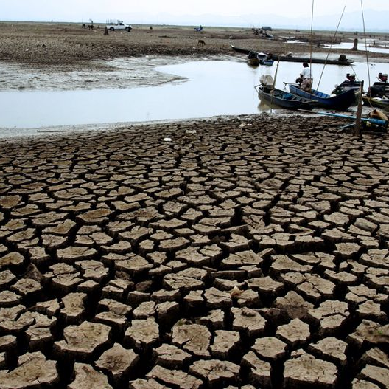
Threats to Water Resources
Overexploitation
Unsustainable water extraction
Groundwater depletion
Pollution
Industrial waste
Agricultural runoff
Climate Change
Altered precipitation patterns
Melting glaciers

Slide 11
Conservation of Water Resources
Sustainable Water Management
Efficient irrigation techniques
Rainwater harvesting
Pollution Control
Wastewater treatment
Regulation of industrial discharges
Restoration Projects
Wetland restoration
River clean-up initiatives

Slide 12
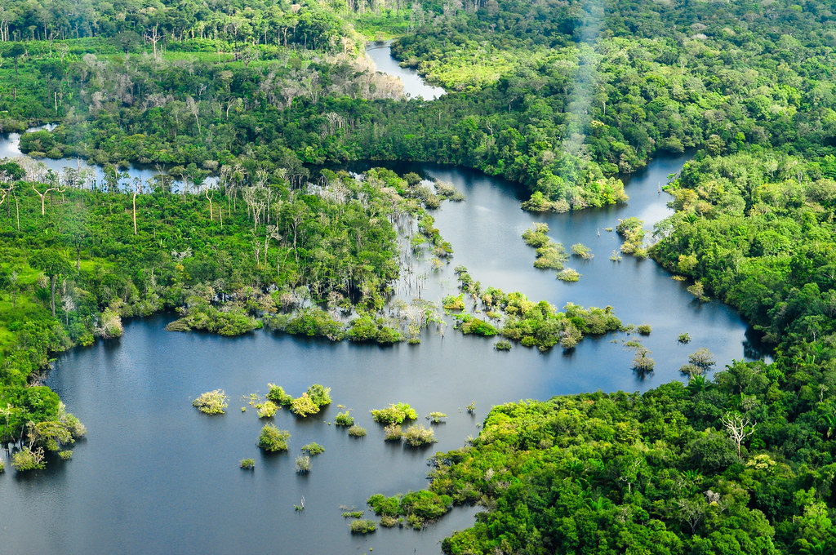
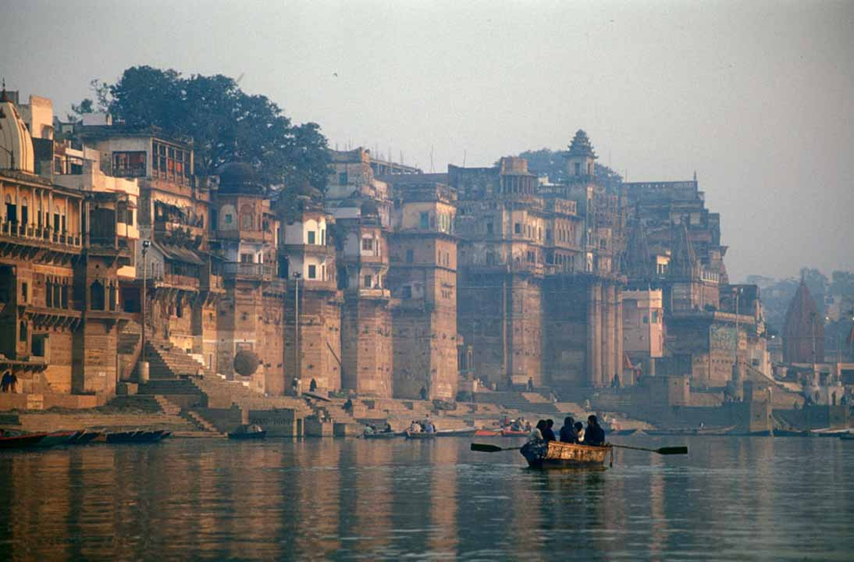
Case Studies
Successful Forest Conservation
Example: Amazon Rainforest initiatives
Results and impact
Successful Water Conservation
Example: River Ganga rejuvenation
Results and impact

Slide 13


QUIZ
The earth's surface covered by water is
71%
80%
60%
65%

Slide 14
QUIZ
Demand for a resources does not change with change in
idea
economy
technology
need

Slide 15
QUIZ
Progress that meets the needs of the present without compromising the ability of future generations to meet their own need is
the tragedy of commons
sustainability development
net primary productive(NPP)
the impossibility theorem

Slide 16
QUIZ
Percentage of water found as fresh water is
87%
3%
97%
75%

Slide 17
QUIZ
Where will the water sit the longest(longest renewal time)?
atmosphere
freshwater lake
glacier
groundwater

Slide 18
QUIZ
Which of the following is a highly exploited water resources?
Water
Air
Soil
All of the above

Slide 19
QUIZ
Only …….% of total water resource is available for human use
0.3%
3%
2.5%
0.1%

Slide 20

Conclusion
Summary of Key Points
Recap the importance, threats, and conservation strategies for both forest and water resources
Call to Action
Encourage sustainable practices
Highlight the role of individuals and communities in conservation efforts
Q&A
Open the floor for questions and discussion

Slide 21
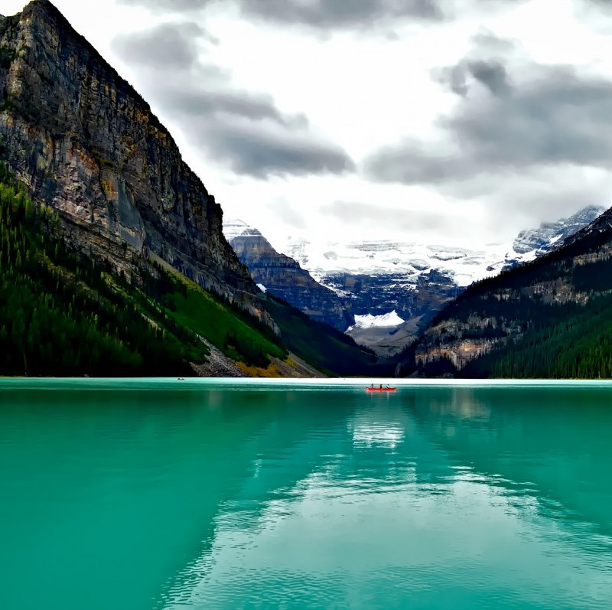
Thank you

